Slide 1
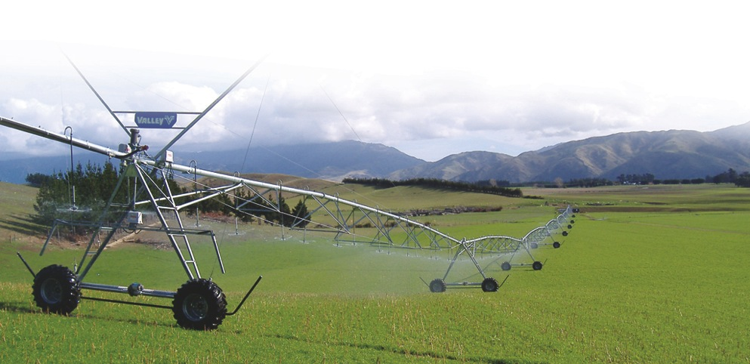
Creating Value Through Irrigation
Black Sea Economic Forum 2015
Aaron Schapper
VP & GM International Irrigation

Slide 2
Sustainability – Water Sources
All Water
Freshwater 3%
Ice Caps
Available Freshwater 33%
Agriculture Uses 66%
of Available Freshwater
Industry and Domestic 33% of Available Freshwater
Notes:
Ag usage of this water to move to 61% by 2025. In developing countries, 80% of water withdrawls are related to agriculture.

Slide 3
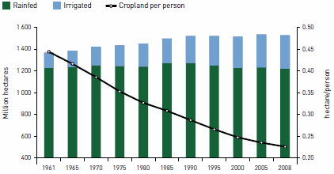
Water: The Limiting Resource
40% of the increase in global food production over the last 50 years came from irrigated farmland.
The area of rainfed agriculture has been largely unchanged for the past 50 years. The area of irrigated farmland has increased over 100%.
Increasing production intensity is critical to achieve food production levels needed to feed a growing global population.
The ability to control the timing of water application makes precision irrigation an important component to more intensive agriculture.
Source: UN FAO 2011
Notes:
9 billion people and dietary changes resulting from rising incomes.

Slide 4
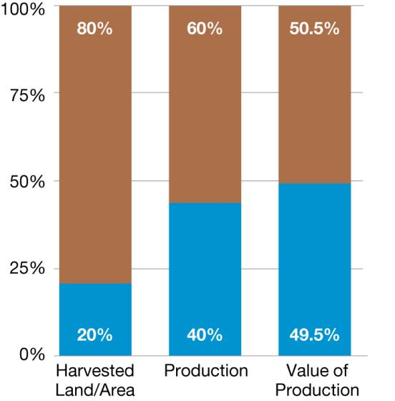
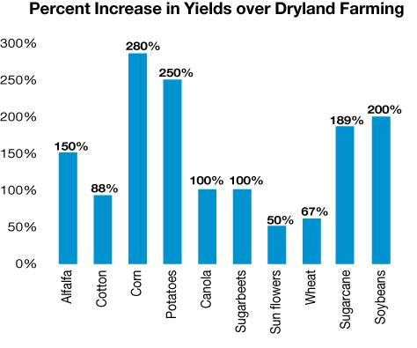
Irrigation vs. Rainfed
Dry land
Irrigated land
FAO Irrigation and Drainage Paper #33, “Yield response to water.”
Notes:
In developing countries, it is 60% of cereal production.

Slide 5
Irrigation Market Segments
Drip
Green House
High Value Crops
<20 Hectares
Irregular Fields
Efficiency: 75- 95%
Mechanized
Cereal Grains
Large Open Fields
>30 Hectares
Potatoes
Efficiency: 75 - 90%
Tree Crops
Vegetables
Sugar Cane

Slide 6
USA – Irrigation Methods

Slide 7
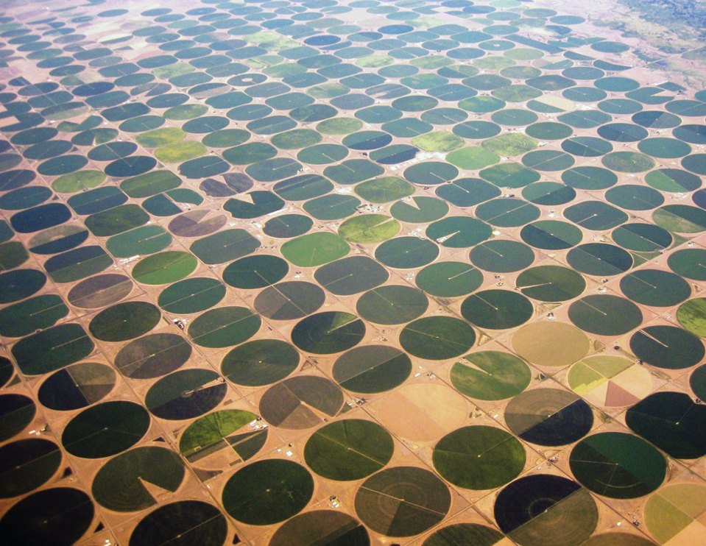
Notes:
80 percent of irrigated land in NE is center pivot irrigated.

Slide 8
Risk Mitigation
Tons Per Hectare
Source: DWWFI 2013

Slide 9
Risk Mitigation
Tons Per Hectare
Source: DWWFI 2013

Slide 10
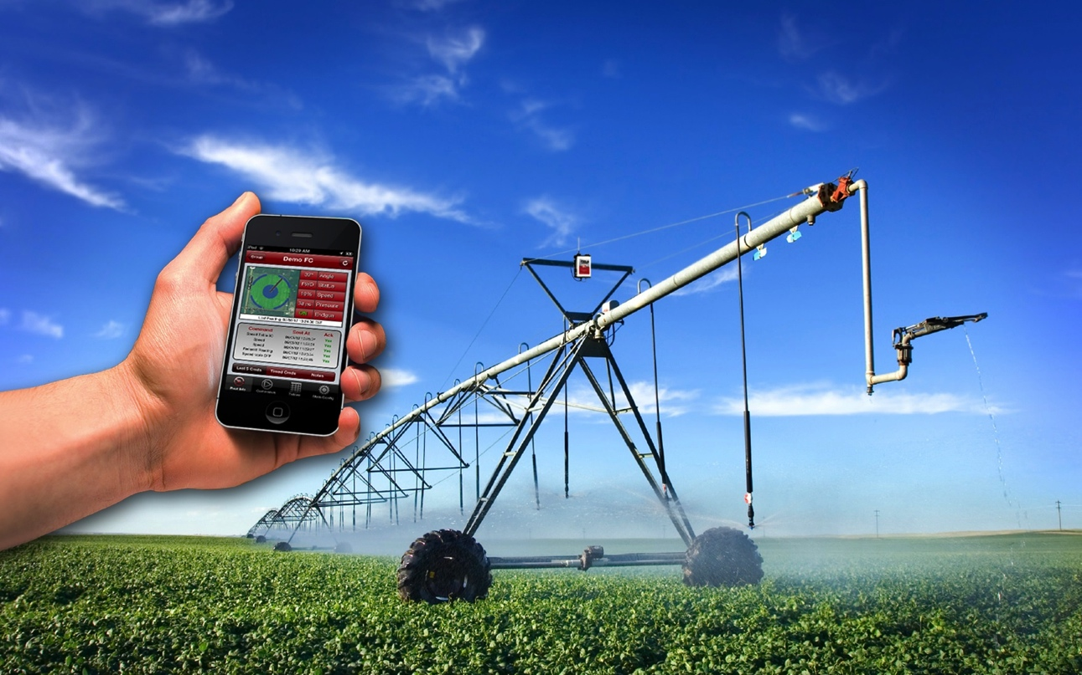
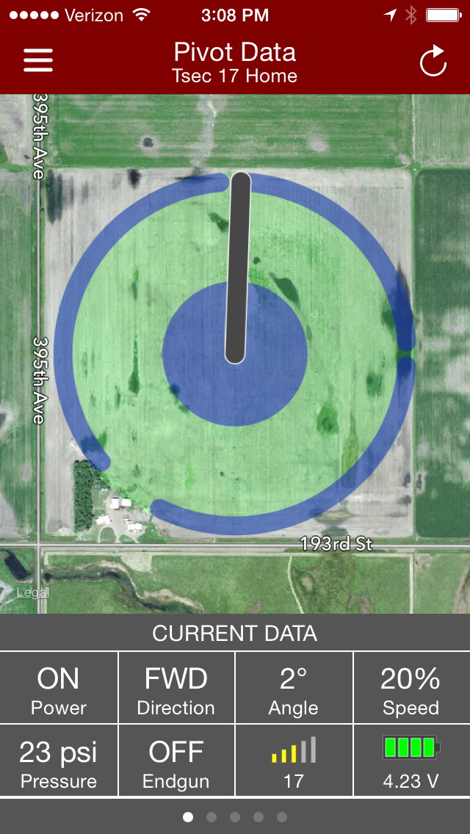

Slide 11
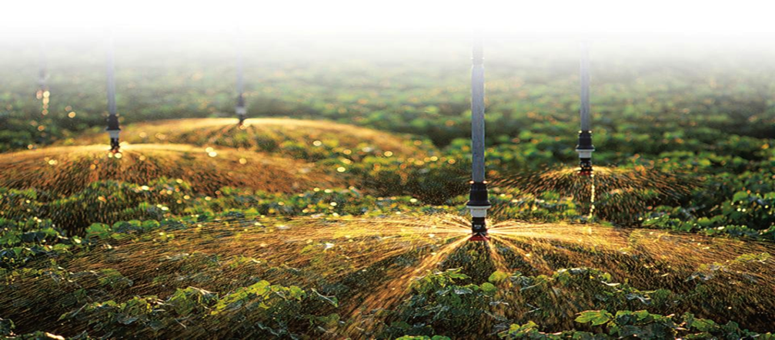
Thank you!

